Slide 1
Insulet Annual Business Review
January – October 2024

Slide 2
LAB Video Slide
Video Link

Slide 3
AGENDA
Cigniti = Coforge
Our Services
Executive Summary
      Pod Functional Team
      POD Automation Team
      SystemsDV Team
Road Map & Ideation
Team Summary & Details
      Pod Functional Team
      POD Automation Team
      SystemsDV Team
6. Appendix

Slide 4









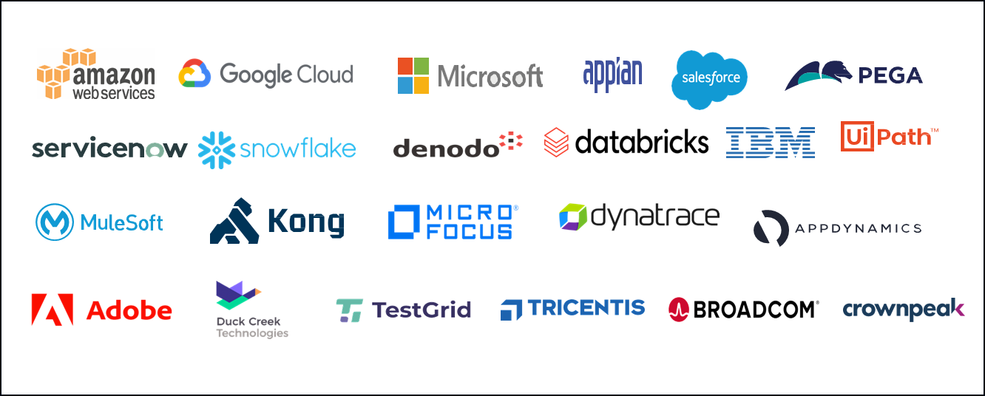










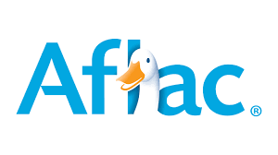

We are a global IT services company
Cigniti + Coforge Combined
An ‘atypical’ IT Services Company
Mission, Vison & Values
$1.34 B
FY24 Revenue*
61+
Forbes Global 1000 clients
Execution Focus
No Surprise
Delivery
Right Sized
Execute at Scale Personal Sponsorship
Transform at the Intersect
Global Footprint
Efficient & Flexible Delivery
Innovation
Thought Leadership
Transform at
the Intersect Efficient & Flexible Delivery
We transform businesses by integrating technology with domain expertise, helping clients achieve growth and efficiency.
10+ years
Average tenure for Top 10 clients
11.5%
Attrition
Engage with the Emerging
Our vision is to leverage emerging technologies and new business models to accelerate impact for clients and their customers.
32,000+
Employees worldwide*
24
Countries
Integrity, Collaboration, Respect, Excellence, Innovation
31
Delivery Centers
96.5%
Repeat Client Business
We pride ourselves on our core values. We believe in always doing the right thing for our clients, partners and each other, working within our local communities to make tangible differences.
CULTURE
Deeply ingrained employee-centricity, long standing partnerships
Lasting Client Relationships
Strategic Partners
HCLS
Others
* Coforge + Cigniti

Slide 5
















Comprehensive suite of services
BFSI
Retail & CPG
Travel, Transportation, and Hospitality
Energy &
Utilities
Healthcare & Life Sciences
Public sector
Data and Analytics
Digital Services
Cloud Services
Cognitive & Generative AI
Application Services
Digital Process Automation
Infrastructure Services
Cyber Security
Salesforce
ERP
Quality Engineering
Business Process Solutions

Slide 6
4/4 CSS for the past 6 years
Executive Summary
Over 550+ person years of Insulet experience
Testing expertise across all Insulet Quality Engineering & R&D teams
POD V&V. & Automation
System DV Testing
PDM Functional & Automation
SFDC QE
DevOps Strategy
SRE & Data Engineering
Data Products Development
Data Cloud QE Strategy
AWS Cloud Engineering
Discover App Performance
Invested $500K+ into Partnership
Healthy internal pool maintained to fulfill swift and critical ramp-ups
Insulet Hub
7+ years of successful partnership
Successful Partnership
Insulet Experience
Services Provided
Cigniti Investment
Dedicated and Secured 150+ Seater Lab for Insulet
Specialised Automation Lab
Device Calibration Partnership
ISO 13485
ISO 17025
HIPPA Compliance
ISO 45001 Certified
POD & PDM Flashing Station
VectorCast
BLE Sniffing tools
Datadog, AWS, Terraform, Pagerduty, Solarwinds, Sonar, Jmeter
Nordic dongles
Helix, Atlassian Tools
Keil
RF Station
Best practices from other HCLS projects
Innovation team
Resource rotation for knowledge optimisation
Inter, Intra project rotation
Formal SME Program
Comprehensive KMF
Customised for Insulet
Management monitoring
Dedicated Medical device tester bench strength
Insulet University
Device Lab @ Offshore
Cigniti Investment
KM Framework
Continuous Improvement

Slide 7








Executive Summary - Pod Functional Team
Multi-Dimensional Test coverage improvement - Build verification testing, Reliability testing, Stress testing, Power consumption testing
Leading and Supporting Insulet product lines (G7, Orion, Atlas, FSL3)
Supported and driven Market Releases – G7 FMR 9.0.3, 9.0.4, L2 Reliability Release, Atlas, Orion LMR
Participated in Dry Runs and DV (10+) across 4 product lines
Ongoing Support - Use case & Gap analysis, Test Case authoring for new development and Moonshot & SA2.0 Regression, Orion DV
5+ Technical reference documents created in all product lines
SQA Process optimizations - Involved in design assessments, Exploratory testing, Ad-hoc testing
Reduction in Test Cycle times through additional long run setups

Slide 8



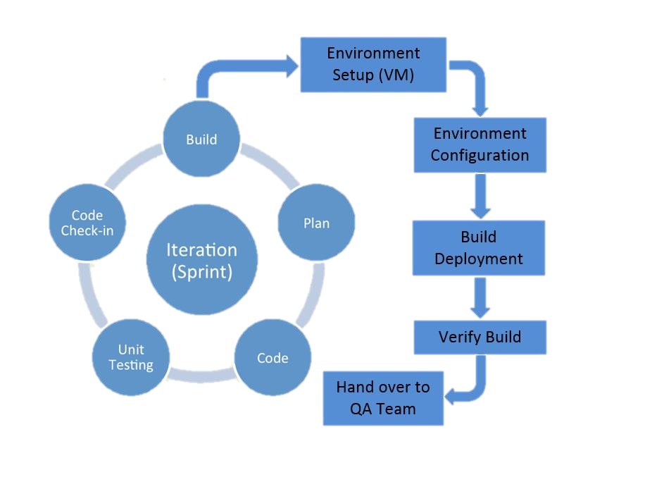
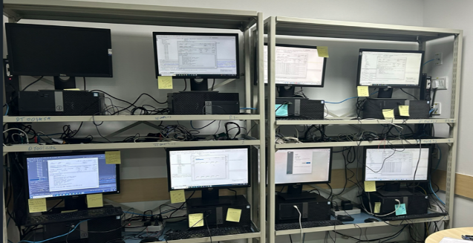

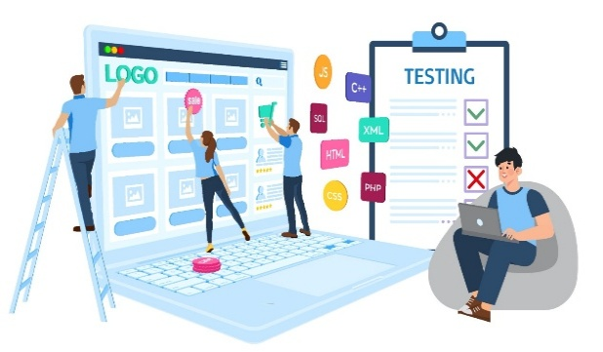

Executive Summary - Pod Automation Team
Enabling 100% Protocol coverage with automation framework including Whitebox and IPC Test cases
Developed a detailed SDD for validating the Pod Algorithm Test Framework
Taking part in PI planning has helped faster automation progress and improved alignment across teams
Automation Test Coverage - 68%.
Test Strategy Improvement for traceability and maintenance through SRS-driven and CGM agnostic approach
Executed over 500+ test cases per sprint reducing functional effort by 240 man-days and accelerating release cycles
Improved efficiency - 44 Test cases optimized to 4 test cases for Smart Adjust 2.0 using PyTest
24x7 Pod Automation Lab

Slide 9


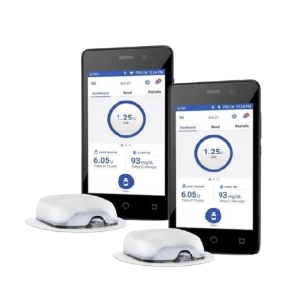




Executive Summary – Systems DV Team
Driven major releases -
iOS – LMR & FMR, v3.0, v3.1, Atlas, SA 2.0 Pivotal, Glooko XT
Test Case Updates, ~3500 DV Test Runs across all Protocols & Product lines
Major contribution in critical releases with a coverage of 85%
Systems lab set up with 80% of equipment at Cigniti offshore
Raised significant defects 369 in all projects that helped product quality improvement
130+ bugs raised in Ad hoc/ Exploratory testing and added additional 30% Functional Test coverage
SME Activities - Enhanced SME team size from 17 to 41
Cross trained professionals of 72 working in Offshore & Onshore model

Slide 10



Value Delivered Through Partnership
Engineering
Business
Partnership
  Supported 15+ Multiple & Parallel DV executions
  Enabled 24/7 Pod Automation Lab
  Initiated Adhoc/Exploratory testing strategy – 150 Defects identified across POD Functional & Automation and Systems DV teams
  New Test Strategy applied for FSL3 - Exploratory Spike testing before feature design to optimize test assessments
  Enhanced Test Coverage - Usecase to SRS mapping, PRS to Test coverage
  Effective participation in all SME activities which includes Initial Reviews, Test Case authoring, Updates, Test Reports and Documents
  Improved Release velocity through leveraging dual shore model
  Reduction of risks with mitigation plan and contingency plans
    DV Readiness checks, Backups for long runs
    Equipment down time challenges
    Initial setup for oscilloscopes
  Weekends and extended support
  Maintaining private pool for Insulet
  Continuous resourcing support based on demand
  80% of equipment set up done at Offshore
  Device calibration capability at offshore
  Shipments based on the requirement and local procurements
  Enhanced dedicated lab setup

Slide 11


Road Map
POD Functional & Automation Team – Regression team ramp-up to reduce release time-lines covering
SystemsDV Team – Enhanced SME and Resource capacity to support the following releases
Q4 - 2024
Q4 - 2024
Orion DV complete (End of November)
L3 Feature Development
Onboard L3 Regression Team
WB to PFIT Conversion
Moonshot CT2 CE DV
SA 2.0 Feature Development and DV
V3.1.4, iOS 1.1.5
V5.0+ v3.0(L3)
Moonshot+ iOS
Atlas, Cloud 4.6.0+, Orion
Q1 - 2025
Q1 - 2025
v3.1.5, v3.1.5/pod 9.0.4, v3.2.0
v4.0 (SA), v5.0+v3.0(L3)
iOS 2.0/ 2.0.1
Moonshot, Android+iOS
Cloud 4.7 and 4.8 US, EU
L3 Feature Development
Increasing Automation coverage to 80% with PFIT conversion
Orion L2 Integration + FMR

Slide 12

Ideation
POD Functional & Automation Team
Systems DV Team
Scale up Automation Lab from 20 to 30 Setups
Insulet HUB - Dashboards from Automation Team
Target to increase Automation TC coverage to 80% by 25Q1
Dedicated Onsite Test Automation Lead for POD automation testing
Capacity planning – Support Test Automaton Framework, Tool Development and Evaluation.
Enhanced Product Support –
  Pod Power Consumption testing
  OTA Functional and Automation team support
  Modular Testing Frame-work
  Internal wear studies
Improve Test Optimization - Dual setups for Functional testers to support long runs and test investigations
  Systems Automation Testing
  Expansion of Battery Life Testing, along with setting up heat bar equipment at Cigniti offshore facilities
  Support HTS Testing (Human Torso Simulator) at offshore
  Compatibility Testing (Multiple PDMs, CGMS & OS versions and Pod variants) – SystemsDV & Automation
  Internalization testing - Cloud Functional and Automation Testing for multiple regions
  Enhance SME Team

Slide 13
Pod Team Summary

Slide 14
Pod Team Journey
Functional Team
Functional Team
  Orion G7 Integration 9.0.4 & Feature complete - 329 executions
Moonshot CT2 CE Regression - 18 executions
SA 2.0 Regression - 7 executions
Atlas DV - 197 executions
Functional Team
Orion G7 Integration 9.0.3 - 109 executions
G6-L2 Reliability Dry runs & DV - 49 executions
Moonshot CT2 CE Regression - 22 executions
Atlas regression & Dryrun - 231 executions
Orion G6 Feature & Regression - 131 executions
CGM Agnostic Analysis - 78 SRS’s
L2 FMR Regression - 23 executions
Moonshot CT2 AB Dry Runs & DV - 20 executions
Atlas Regression - 265 executions
Automation Team
Orion G7 Integration 9.0.4 & Feature complete - 3770 executions
G7 FMR 3 Regression - 657 executions
Moonshot CT2 CE Regression - 186 executions
Tool Validations - 11 executions
Automation Team
Orion G7 Integration 9.0.3 - 3231 executions
G7 FMR 2 Regression - 250 executions
G7 FMR 3 Regression - 807 executions
CGM Agnostic Conversions (Ph 2) - 20 test cases
G6-L2 Reliability Dry runs & DV - 407 executions
Moonshot CT2 CE Regression - 186 executions
PACT dry runs & DV - 150 executions
Automation Team
Orion G6 Regression - 3113 executions
G7 FMR 1 Regression - 1426 executions
CGM Agnostic Conversions - 117 test cases
Moonshot CT2 AB Dry Runs & DV - 664 executions
PACT Feature complete - 150 executions
Team Size: 44
Team Size: 39
2024-Q3Q4
Team Size: 35
2024-Q2
Generated G7 9.0.4 Release DV documentation
Initiated BVT and weekend Reliability testing in Libre3
Initiated L2 continuous Reliability testing with 5 Orion setups
Supported OTA team with build compatibility verifications
Created SDD for Orion Pod Algorithm Test Framework
2024-Q1
Supported Orion PFIT conversion
Supported Orion Link Layer and SDK Updates
Supported for 0x10 Alarm and Wakeup Adhoc testing in Atlas
Initiated L3 Functional and Automation parallel collaboration
Automation Leads travelled to onsite for PI3 planning
Supported G7 Pod 9.0.4 Release handling with new SiLabs and duplicate EGV issues Adhoc testing
Supported Orion Link Layer and SDK Updates
Supported G7 Pod 9.0.3 Release handling FRA, Pod swap, duplicate EGV, 0x22 issues Adhoc testing
CGM Agnostic Design discussions

Slide 15
Orion
Functional Team
Supported integration of Link Layer (6 versions) and NXP SDK with Pod code base
Executed 378 regression test runs and reported 28 new Pod bugs
Reliability testing was performed with 7 setups over 36 weekends with 252 pods
BVT on all branch and develop builds as a new practice
Supported BLT, Power Analyzer and BOD testing at onsite
Worked on Analysis for using BPA Analyzer vs Wireshark tool validation
Automation Team
Executed 500+ test runs for each sprint build as part of regression
Executed 10,114 regression test runs and reported 11 new Pod bugs
Performed BVT on all branch builds before Pod code merge into develop branch
Successfully completed 3 iterations of LMR Dry Run's for all 803 automated test cases including Algorithm tests
Increase in Test Execution count during Q3 due to 3 sets of LMR Dryruns

Slide 16
G7 & CGM Agnostic
G7 Functional Team
Drove the FMR 2(9.0.3) and FMR 3(9.0.4) Release effort with Cigniti SQA, Insulet SQA and GL SQA Team for Pod Swap, Duplicate EGV and 0x22 Alarm and compatibility for SiLabs Sensor
Supported with DV Documentation creation as a part of FMR 2(9.0.3) and FMR 3(9.0.4)
G7 Automation Team
Supported the FMR 2(9.0.3) and FMR 3(9.0.4) Release effort along with the SQA Team
Updated 26 test cases as part of G7 9.0.4 Release changes
Performed Confidence testing for G7 FMR-2 over the weekend and completed 527 Test Runs
CGM Agnostic Automation Team
CGM Agnostic approach was mainly to have the test cases compatible across all the CGM sensors
Automation team Authored 117 test cases with SRS driven model
Existing 112 test cases from ALH protocol converted to 117 Agnostic conversation which is compatible for 3 Sensors (G6/G7/L2)
Decrease in Test Execution count during Q2 & Q3 due to execution of selected protocols for G7 FMR

Slide 17
Libre2 & Libre3, PACT
Libre2 FMR (G6/L2 Reliability Release) Functional Team
Supported for Libre2 Pod FMR and G6/L2 Reliability Release
Updated 3 test cases as a part of Libre2 FMR
Completed Dry run and DV with 49 test executions
Supported BLT testing and PDM build verification testing
Automation Team
Completed Dry run and DV with 407 test executions
Libre3 Functional & Automation Team
Participated in design assessments
Authored 42 use cases scenarios and 21 automation test cases
Performed functional ad-hoc testing and 294 regression executions
Initiated weekend Reliability testing on 8 setups
Reported 12 bugs across Pod, PDM and PAF
PACT Functional Team
Authored 150 test cases and additional 150 executions for regression
Logged 90 bugs on PACT which were fixed and re-tested

Slide 18
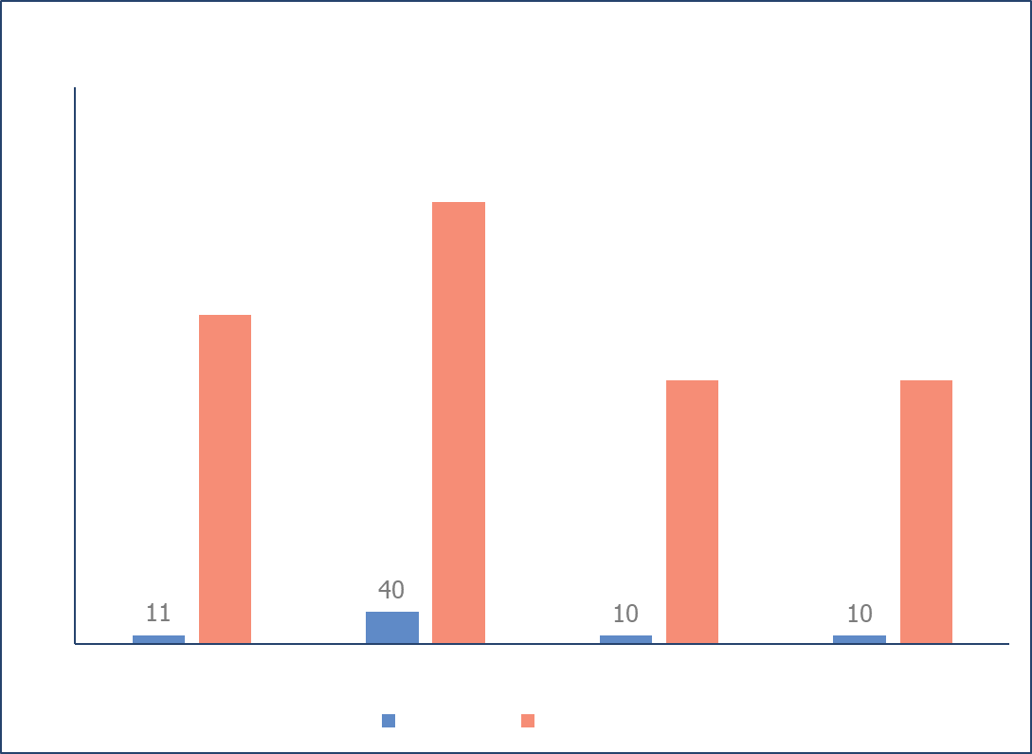
Moonshot
Moonshot Functional & Automation Team
Successfully completed Dry Runs, totaling 342 test cases, including 193 algorithm, 139 automated and 10 manual test cases in CT2 AB
Successfully signed off the Moonshot CT2 AB DV
Authored 52 new automated and 1 manual test case for the newly developed Autobolus 2.0 feature in CT2 CE release
Executed ad-hoc testing on 27 Pod scenarios and 22 scenarios on PDM build.
Smart Adjust 2.0 Functional & Automation Team
Authored 16 automated and 2 manual test cases for the newly developed ADR (Automated Delivery Restricted) feature in SA 2.0 release
Optimized 43 Input Structure Algorithm test cases into 4 test cases using Pytest for improved efficiency
Orion Algorithm Tool Validation Automation Team
Developed a comprehensive software detail design document and successfully developed and executed 11 test cases to validate the tool’s functionality and ensure its accuracy
Increase in CT2 AB regression count due to multiple iterations of regression testing

Slide 19
Atlas
Atlas Functional Team
Analyzed the open defects from other Pod platforms & tested them in Atlas setup proactively
Ad-hoc testing performed to reproduce the 0x10 Alarm and Wake up testing
Total of 693 Test runs were completed for this project
Supported multiple iterations of testing for below functionalities and defects,
  Initialization Code changes
  Flash Encryption
  Binary Verification for Manufacturing Team
  Delay in Pod-PDM Communication
  LDO Trim Change
  Time based Occlusion regression
  Stack size changes
Team was ramped up to 4 HC to support Dry run and DV
Successfully signed off the Atlas DV after dry runs with 100% pass percentage

Slide 20
Overall Test Cases - Protocol summary
68.1% (946 out of 1388) of tests have been automated for the Project by 2024

Slide 21
24x7 Test Automation Lab utilization
In July, August and September months Lab Utilization improved due to Multiple Dry Runs for Orion LMR and SA 2.0

Slide 22
24x7 Automation Lab Test Case Execution Summary
In January, April and July months Test Script execution count is High due to Multiple Dry Runs for Orion, G7 and SA 2.0

Slide 23
Systems DV Team Summary

Slide 24
  Systems DV Team – 2024
DVs
DVs
DVs
3.0 G6/G7 DV
Libre 2.0 Clinical DV
Cloud 4.4.2 DV
DVs
iOS 1.1 FMR DV, Reg DV
Atlas DV
Smart Adjust 2.0 DV
v3.1, 9.0.4 DV
GRS DV’s - v3.1, iOS 1.1 Reg
iOS FMR 1.1.3 DV
iOS 18 CCC DV
v3.1.2 DV
iOS 1.0 LMR DV
G6 France Glooko XT DV
Libre v2.0 Pod Reliability DV
v3.0.1 & 9.0.3 DV
Moonshot CT2 A-B DV
Team Size: 72
Team Size: 50
Team Size: 72
Team Size: 65
2024-Q4
Apr’23 – Aug’24
2024-Q3
2024-Q2
2024-Q1
Gained knowledge in handling various sensors and pods
  Pods - Atlas, Orion, G6, G7, Libre
  Sensors - WAB, G6, G7 Emulator boards, Si-Lab, V&V, Production Equivalent, Libre E, E2 etc..
Pod Programming
  Built the competency to work on multiple programming stations to program the pods for Atlas, Orion, G6 G7, Libre, Op5 Gen1
Owned maximum protocols
Performed below activities in parallel to DVs:
  iOS FMR Pre & Final Dry runs
  Atlas Reg , v3.1.1, v3.1.2, Dry runs
  Cloud 4.6.0 CVST EU Dry runs
  Libre 3 Integration1 Dry runs
  Orion Final Dry runs
GRS/ GUI Defect Retesting
iOS 2.0 G6/G7 integration testing
Phyton version has been updated to v6.31.01
Ad-hoc Testing for all the projects and identified 55+ defects
Performing below activities in parallel to DVs:
  iOS 1.1.3 Dry runs
  Cloud 4.6.0 US Dry runs
  v2.0 Dry runs
iOS 2.0 weekly regression testing
iOS 1.1.3 GRS DV Testing
Hardware: Additional Laptops, RF boxes initiated
Ad-hoc Testing for all the projects and identified 5+ defects
Along with major DVs, supported below Activities:
  iOS LMR Final Dry runs
  PEIT, BLT Testing
  9.0.3 Effort
Hardware: Additional SI tool setups
Ad-hoc Testing for all the projects and identified 40+ defects
  Base lined and identified adhoc scenarios
Performed below activities in parallel to DVs:
  Weak Signal, External Flash Reliability Testing
  9.0.3 PEIT
  V3.1 Final Dry runs
  Orion IP7 Dry runs
  Atlas Final Dry runs
Battery Life Testing Support
SME activities for all the protocols
  Initial Reviews, Test Case Updates, Test Reports support
Hardware: Additional devices of Samsung S22 and iPhones
Ad-hoc Testing for all the projects and identified 30+ defects

Slide 25
  Project Wise DV Release Trends
Verified 1586 GRS Screens comparing with UX Specs/Design Documents across multiple DV's

Slide 26
  Systems DV Team – BLT (Battery Life Testing)
  Led and played a key role in BLT testing activities across various product lines (Atlas, G6 G7, Orion, PEIT, etc.), ensuring high-quality deliverables
  Statistical accuracy and reliability in performance metrics were achieved with an increased sample size from 14 to 64
  Reduction in operational delays and maximization of resource utilization was ensured with full-time availability of trained resources from #1 to #3
  Efficiency in testing cycles and reduction in overall testing timelines achieved with parallel battery life requests on- Dash, Dash BYD, libre2.0, Atlas, 3.1, 9.0.4, OP5
  Supported Automation team on Accurate estimation of device set up and supported setting up sample size, provided understanding on typical use for operational efficiency
Battery Life Tests Summary:

Slide 27
  Systems DV Team – Defect Summary
Overall, 369 defects were logged across all projects in Dry Runs, DVs & Exploratory Testing​
Logged 22% of functional defects in multiple DV’s - Improved the quality of the product
Proactively led and consistently applied efforts in ad-hoc and exploratory testing across all product lines, utilizing diverse approaches and methodologies
Identified 130 defects for ad-hoc/exploratory

Slide 28
Let’s engage!

Slide 29
Appendix

Slide 30


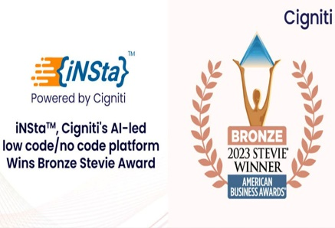
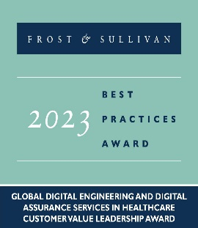



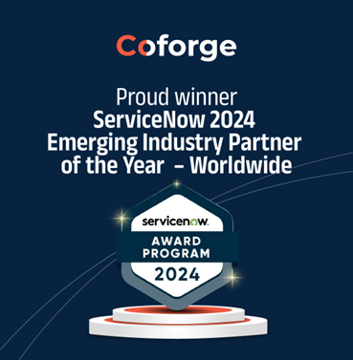






Recognizing Excellence: Our Awards and Accolades
Global analysts consistently recognize us as a leader in Multiple Services Spectrum
Leader, Innovator, and Major player in the NelsonHall NEAT QE Hyper automation Insight- 2023
Recognized as a Leader in Forrester Wave™
Midsize Agile Software Dev Service Providers
Leader in the Quality Engineering (QE) Specialist Services PEAK Matrix Assessment 2023.
Star Performer & Major Contender in the Everest Group’s Next-Generation QE Services.
Positioned as a Leader in RPA services
Recognized as a ‘Leader’ in the Cloud Advisory
Assessment and Migration Evaluation by Nelson Hall
Leader in the US region for Continuous Testing Services.
Notes:
Best IoT Healthcare Platform” in the 2023 MedTech Breakthrough Awards Program
Best Tech Brand 2023 by Economic Times Edge

Slide 31










Medical Devices Center of Excellence
Service Spectrum
800+ MedTech Professionals
End to End Services
- Development, Test , Deploy, Monitor, Data , Integrations etc.
Data and Analytics
Digital Experience & Process Automation
Comprehensive Device Assurance Framework (App-Infra-Data Assurance)
Application Services
Compliance Consulting
Salesforce
ERP
Best IoT Healthcare Platform 2023 MedTech Breakthrough Awards
ISO 17025
Cloud Services
Cognitive & Generative AI
Infrastructure Services
Cyber Security
Regulatory Compliances
Key Clientele
Quality Engineering
Business Process Solutions
FDA
MHRA
ISO 13485
ISO 14971
IEC 62304
IEEE 2621
Lab Setup as a Service
Device verifications & Validation

Slide 32
Comprehensive Services We Offer
32
Data and Analytics
Using cross-industry expertise and best-fit tools, our services integrated approach helps us create an enterprise view of data for informed decisions.
Advisory
AI & ML
Data Engineering
Analytics, Insights & BI
Data Operations
Data Science
Data Assurance
Digital Services
We leverage our industry and digital expertise to deliver effective and emotionally empathetic experiences to our clients’ customers.
Interactive Services
Product & Platform Engineering
Connected Enterprise/ Devices
Enterprise Application Integration
Intelligent Automation / RPA
Omni Channel Testing
Cloud Services
With a right Cloud enablement partner, experience and proven templates for implementation, we enable organizations to connect through all the layers. Interactive Services
Advisory Services
Migration Services
Operation Services
Security Services
CloudPixy -Cloud Management Platform
Cloud Migration Assurance
Cognitive & Generative AI
Helping our customers with comprehensive AI services for building intelligent applications and addressing business needs. Quasar – an AI platform designed to build Enterprise AI capabilities for:
DocumentAI for Text & NLP
SpeechAI for Voice Analysis
PredictAI for Predictive & Prescriptive models
VisionAI for Images & Videos Analysis
GraphAI for Entities & Relationships
ConversationalAI for chatbot & voice bot
Application Services
We seek to transform organizations by leveraging DevOps, Open Source, Microservices architecture, Automation, AI, Blockchain, and Agile models.
Advisory & Consulting
Development & System Integration
Maintenance & Support
Modernization
Program Management
Digital Process Automation
Dedicated DPA practice supports Pega, Appian, Outsystems, Mendix, and Microsoft Power Apps platforms to provide:
AI Centric Strategy & Consultation
Implementation & Integration
User Experience & Design
Upgrade, Support & Maintenance
Intelligent Automation
Business Assurance Testing

Slide 33
Comprehensive Services We Offer
Infrastructure Services
Our services seamlessly blend business and IT, optimizing operations and enhancing performance. We maximize performance, availability, and resilience through advanced tools like analytics, automation, and AIOps, driving transformative results.
Anyplace Workplace
ServiceNow
Anywhere Data Center
Service Integration
Always-on Network
Chaos Engineering
Cyber Security
Our integrated security solution that achieves a cohesive security environment providing real-time preventive and detective response capabilities
Threat Intelligence
Phishing Analysis
Security Incident Management
Vulnerability Management
Identity and Access Management
Governance & Risk Management
Threat Modeling
Penetration Testing
Salesforce
Global Strategic Partner to Salesforce, leveraging MuleSoft and Salesforce to provide:
Strategic Advisory and Consulting
Implementation and integration
Platform & Data Migration
Business Process Optimization
Support and Maintenance
Enterprise Application Testing
ERP
ERP practice facilitates the adoption of SAP, Oracle, MS Dynamics addressing complex enterprise transformations through:
Strategic Planning
Implementation and integration
Platform and Data Migration
On prem to cloud migration
Business Process Optimization
Support and Maintenance
Enterprise Application Testing
Quality Engineering
Functional Testing
Non-Functional Testing
End-to-end Automation
Performance Engineering
TDM and TEM
Service Virtualization and API testing
AI & ML Infused Testing
DevSecOps
Resiliency
Business Process Solutions
The dedicated BPS group caters to Banking & Financial Services, Insurance, Title Tax Settlement, Mortgage, Travel & Hospitality domains to provide:
Business Transformation with a ‘Digital First’ approach
Intelligent automation & staffing
Automated QC, Risk management & compliance
Business Assurance Testing

Slide 34
Road Map
POD Functional & Automation Team – Regression Team ramp-up to reduce release time-lines covering
SystemsDV Team – Enhanced SME and Resource capacity to support the following Releases
V3.1.4, iOS 1.1.5
V5.0+ v3.0(L3)
Moonshot+ iOS
Atlas, Cloud 4.6.0+, Orion
Orion DV complete (End of November)
L3 Feature Development
Onboard L3 Regression Team
WB to PFIT Conversion
Moonshot CT2 CE DV
SA 2.0 Feature Development and DV
Q4 - 2024
Q1 - 2025
Q1 - 2025
v3.1.5, v3.1.5/pod 9.0.4, v3.2.0
v4.0 (SA), v5.0+v3.0(L3)
iOS 2.0/ 2.0.1
Moonshot, Android+iOS
Cloud 4.7 and 4.8 US, EU
L3 Feature Development
Increasing Automation coverage
to 80% with PFIT conversion
Orion L2 Integration + FMR
Q1 - 2025

Slide 35
Ideation
POD Functional & Automation Team
Systems DV Team
Scale up Automation Lab from 20 to 30 Setups
Insulet HUB - Dashboards from Automation Team
Target to increase Automation TC coverage to 80% by 25Q1
Dedicated Onsite Test Automation Lead for POD automation testing
Capacity planning – Support Test Automaton Framework, Tool Development and Evaluation.
Enhanced Product Support –
  Pod Power Consumption testing
  OTA Functional and Automation team support
  Modular Testing Frame-work
  Internal wear studies
Improve Test Optimization - Dual setups for Functional testers to support long runs and test investigations
  Systems Automation Testing
  Expansion of Battery Life Testing, along with setting up heat bar equipment at Cigniti offshore facilities
  Support HTS Testing ( Human Torso Simulator ) at offshore
  Compatibility Testing (Multiple PDMs, CGMS & OS versions and Pod variants) – SystemsDV & Automation
  Internalization testing - Cloud Functional and Automation Testing for multiple regions
  Enhance SME Team

